Slide 1

Multistage Attack on a Linux Server
Jan Büchele und Henrik Lümkemann
19.06.2025
Cyber Security – Isabel Wagner

Slide 2




What is our Project about?
Our Attack
Gain illegitimate access
Compromise the system

Slide 3
Problem Statement
Company Server with limited directory access for employees
The server can only be accessed via ssh
Sensible data is stored on the company server
Confidential Company Data can only be accessed by root

Slide 4

What are our adversaries?
External adversary
Steal or encrypt data for ransom
Malicious Insider
Possible whistleblowing

Slide 5

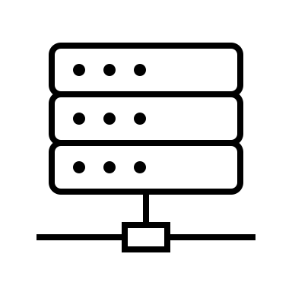
How do we gain access?
SSH2_MSG_USERAUTH_REQUEST
Normally:
Please authenticate yourself!
client
SSH2_MSG_USERAUTH_SUCCESS
With libssh vulnerability:
Perfect, welcome in here is your shell!
client

Slide 6

Why is this dangerous? (CVE-2018-10933)
CVSS Rating of 9.1
No authentication required.
Exploitable over the Network
Easy to exploit -> More attackers
Possibly shell access on the system -> Further attacks possible

Slide 7
Dirty COW explained – How to gain root access?
File Contents
(Read-Only)
Hard Drive
Virtual Memory
Main Memory

Slide 8
Dirty COW explained – How to gain root access?
File Contents
(Read-Only)
Pointer made by mmap()
Hard Drive
Virtual Memory
Main Memory

Slide 9
Dirty COW explained – How to gain root access?
File Contents
(Read-Only)
Pointer made by mmap()
File Contents
(Private copy)
Hard Drive
Virtual Memory
Main Memory

Slide 10
Dirty COW explained – How to gain root access?
File Contents
(Read-Only)
Pointer made by mmap()
File Contents
(Private copy)
Hard Drive
Virtual Memory
Main Memory

Slide 11
Dirty COW explained – How to gain root access?
File Contents
(Read-Only)
Pointer made by mmap()
File Contents
(Private copy)
Hard Drive
Virtual Memory
Main Memory

Slide 12
Dirty COW explained – How to gain root access?
File Contents
(Read-Only)
Pointer made by mmap()
Hard Drive
Virtual Memory
Main Memory

Slide 13

Why is this dangerous? (CVE-2016-5195)
CVSS Rating of 7.8
The attacker must have local access to the system to run the exploit
The exploit is easy to execute
The exploit provides full root

Slide 14
Our Exploit Setup
Linux VM version 16.04
Libssh version 0.7.4 -> In exploitable range
Linux Kernel version 4.4.0-21-generic -> In exploitable range (Dirty COW)
The VM was emulated on a Windows PC with the VMWare software –> important for nano to work

Slide 15


Our Exploit Plan
DEMO

Slide 16
Our Mitigation Strategies
Libssh
Dirty COW
We create an additional flag, only set after password authentication
Only after this flag was set, does the client get acces
The server automatically disconnects after a set time if flag is not set when SSH…SUCCESS is sent
Uninstalling gcc and other development tools
Mount user-writable directories with the noexec flag to prevent the execution of any uploaded or created binaries

Slide 17

Questions?

